Slide 1
Chapter-4-Image Filtering Part-2 Dr. Mohamed Waleed Fakhr 2023 Frequency-Domain Filtering & Image Restoration

Slide 2
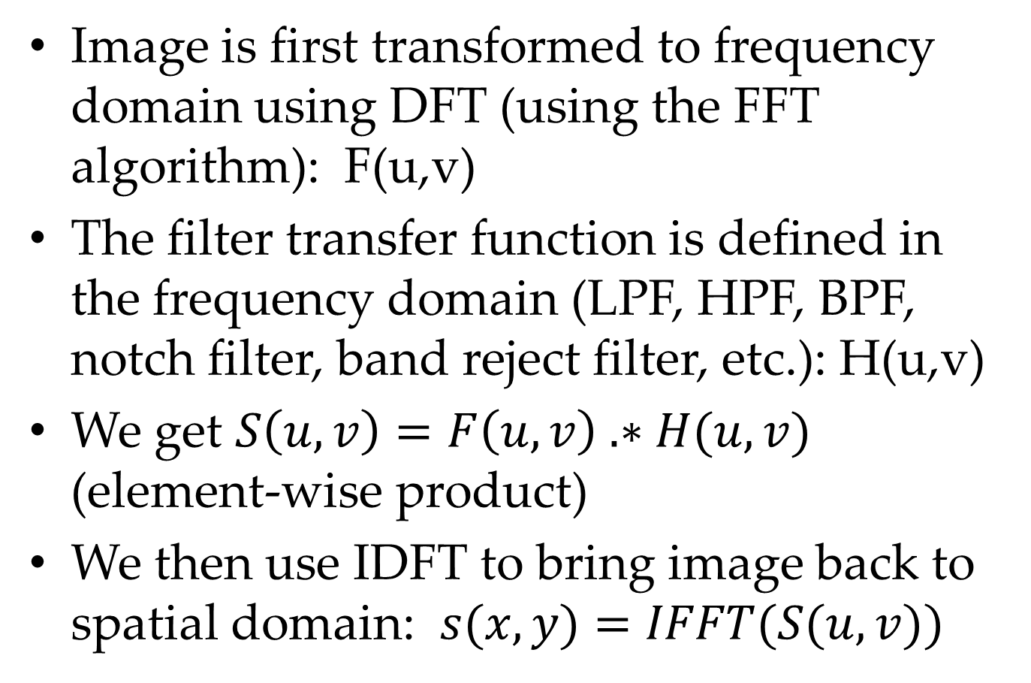
Frequency Domain Filtering
Image is first transformed to frequency domain using DFT (using the FFT algorithm): F(u,v)
The filter transfer function is defined in the frequency domain (LPF, HPF, BPF, notch filter, band reject filter, etc.): H(u,v)
We get $S\left(u,v\right)=F\left(u,v\right) .∗H(u,v)$ (element-wise product)
We then use IDFT to bring image back to spatial domain: $s(x,y)=IFFT(S(u,v))$

Slide 5
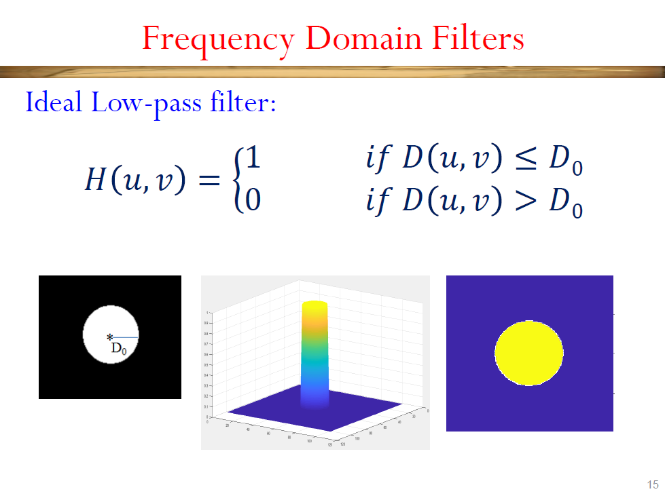

Slide 6
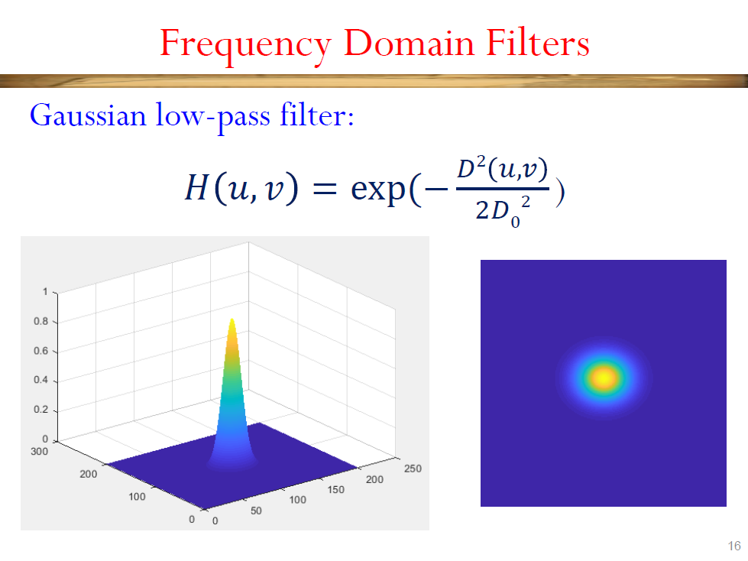

Slide 7
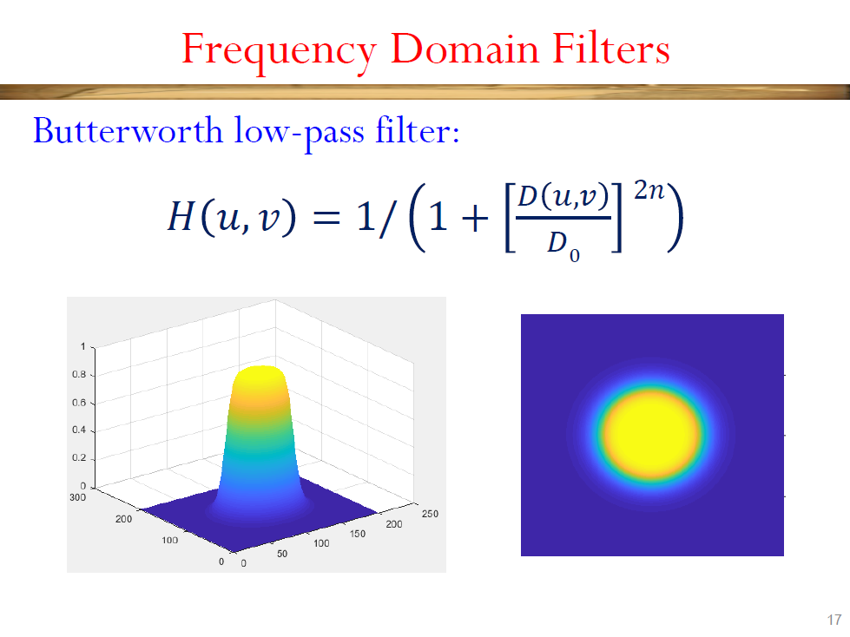

Slide 8
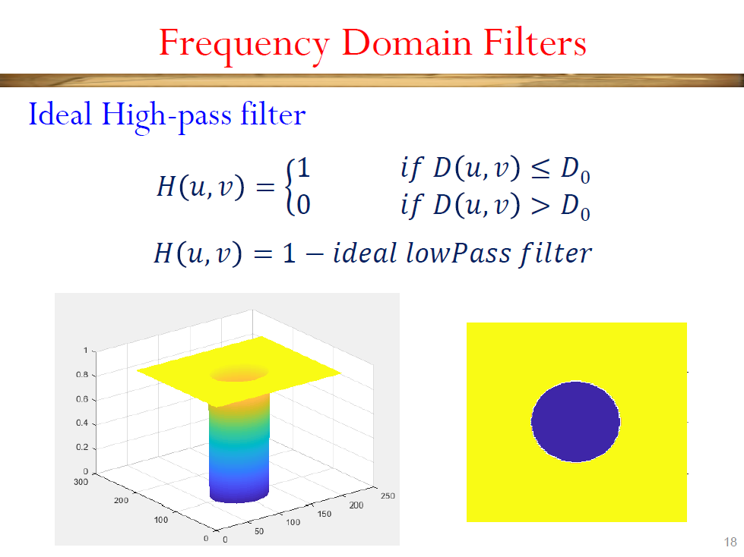

Slide 9
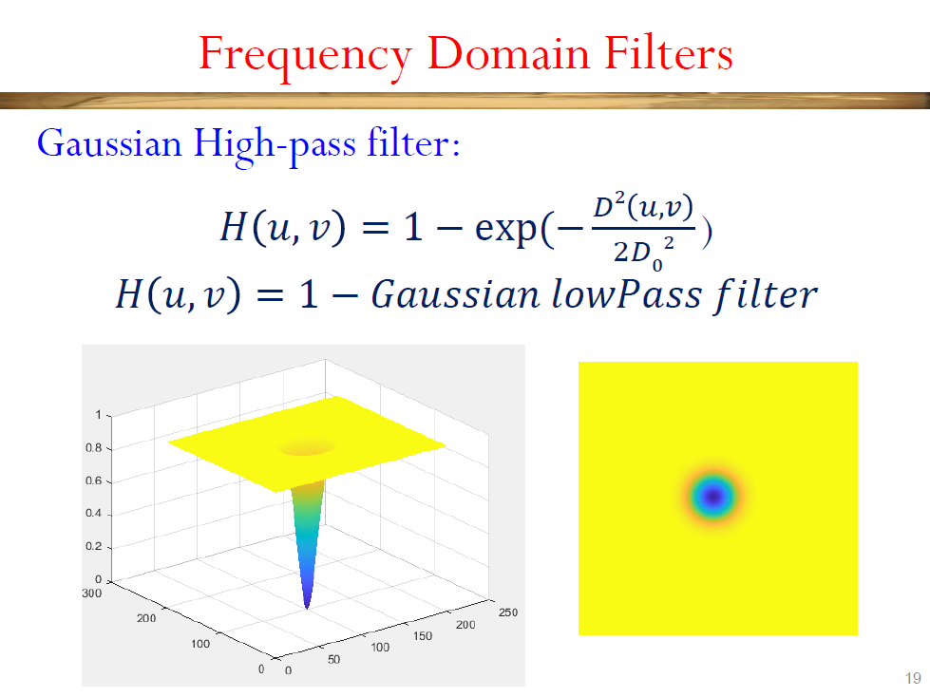

Slide 10
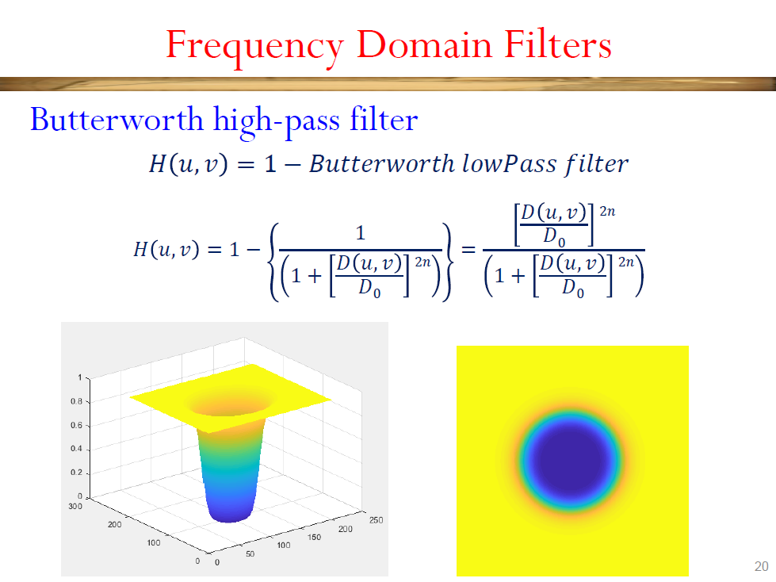

Slide 11
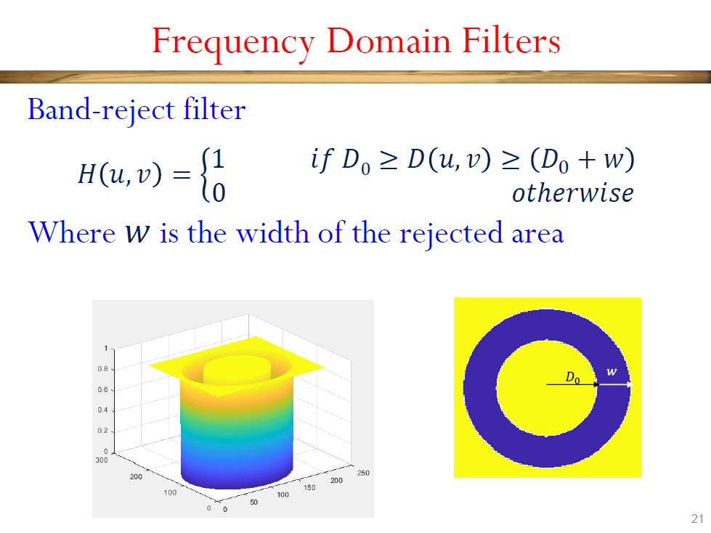

Slide 12
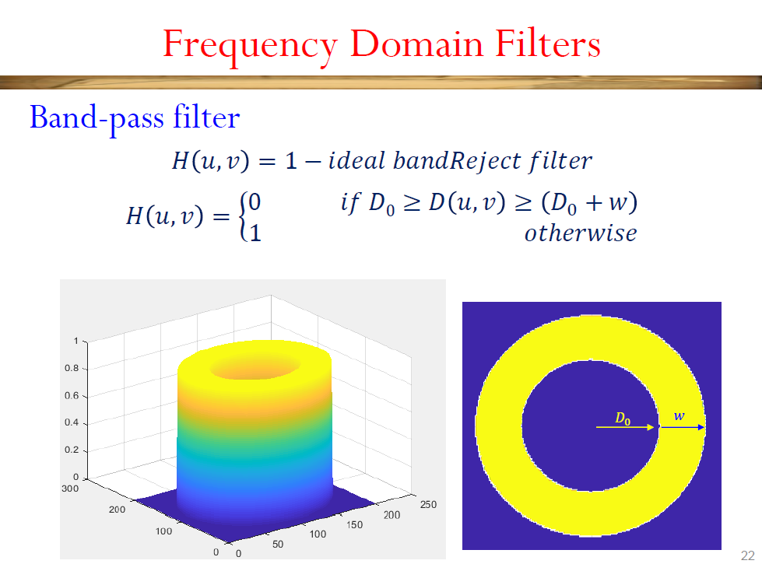

Slide 13
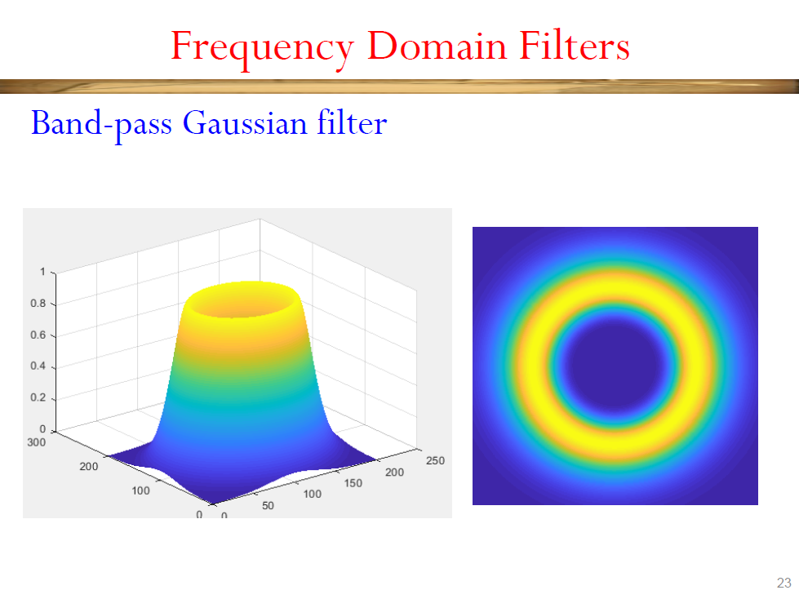

Slide 14
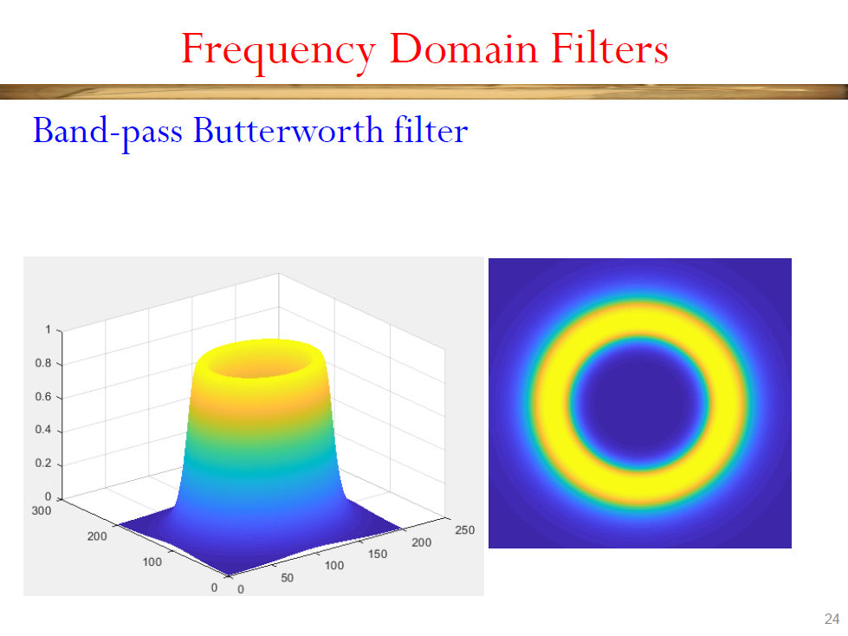

Slide 15
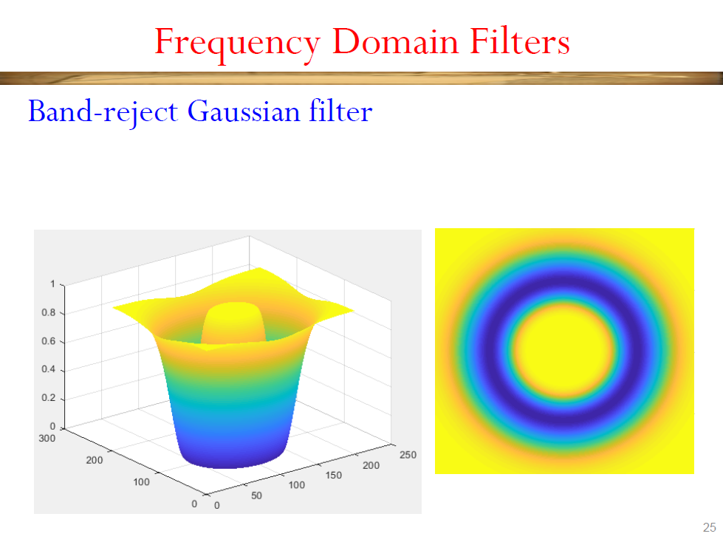

Slide 16
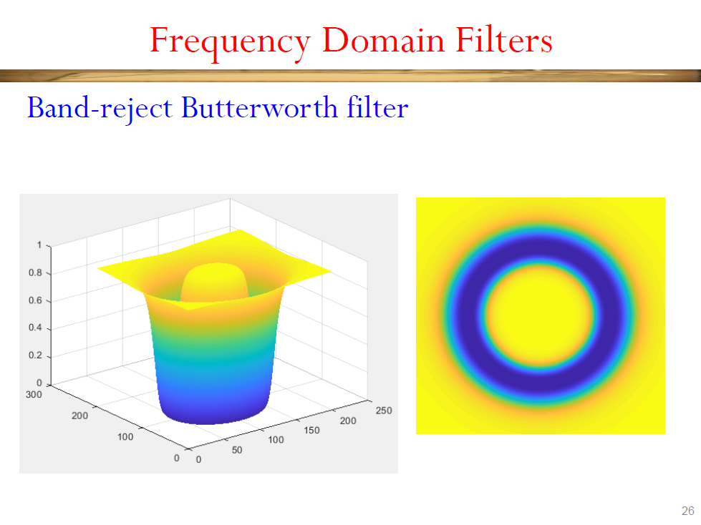

Slide 17
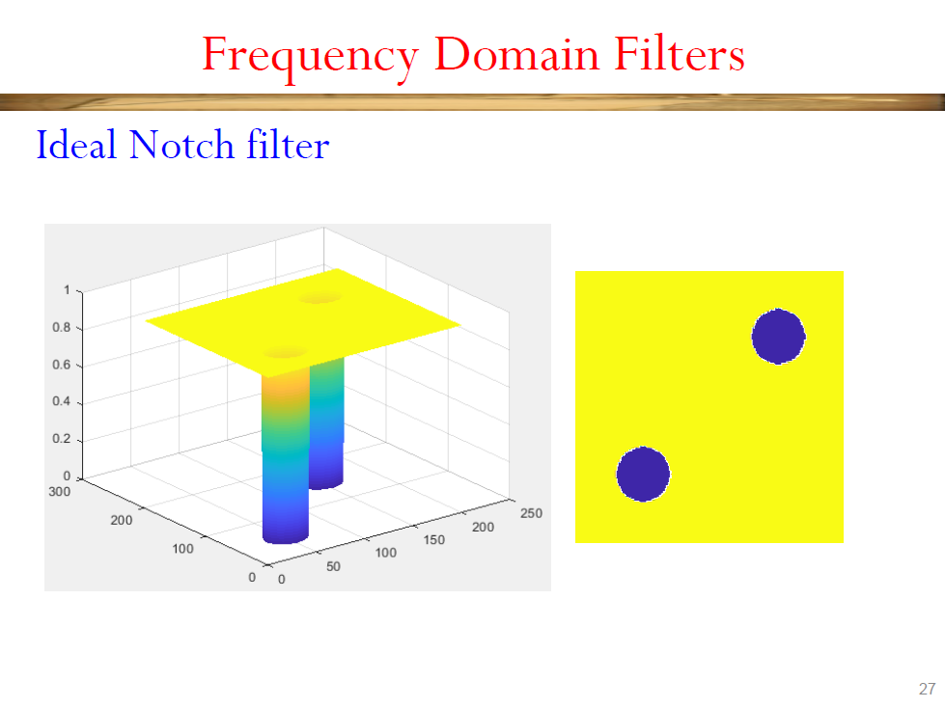

Slide 18
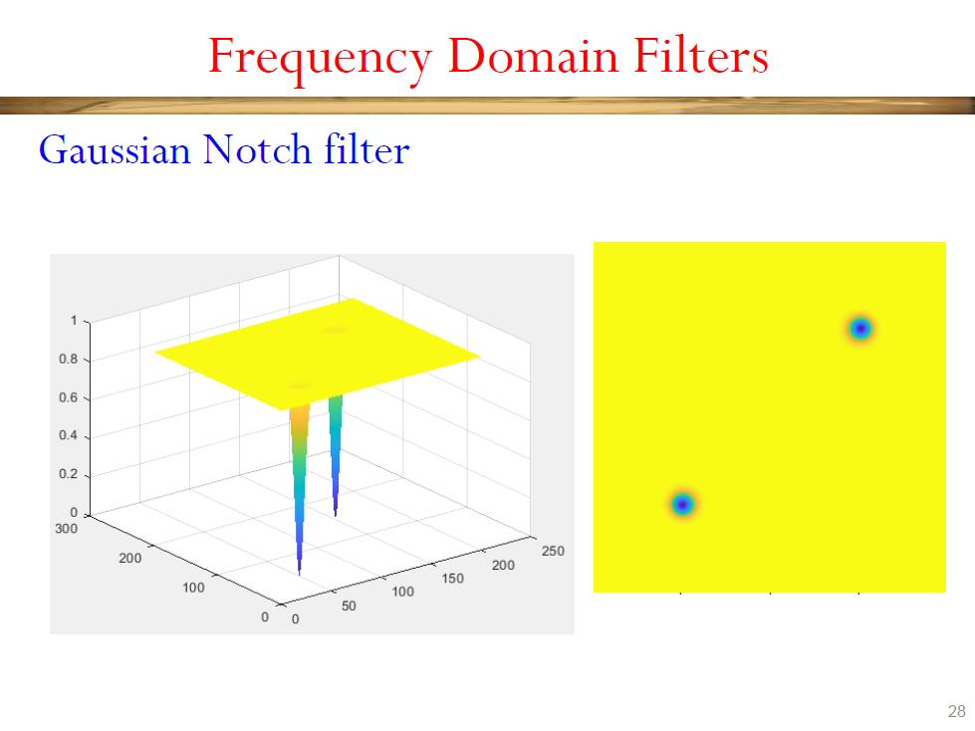

Slide 19
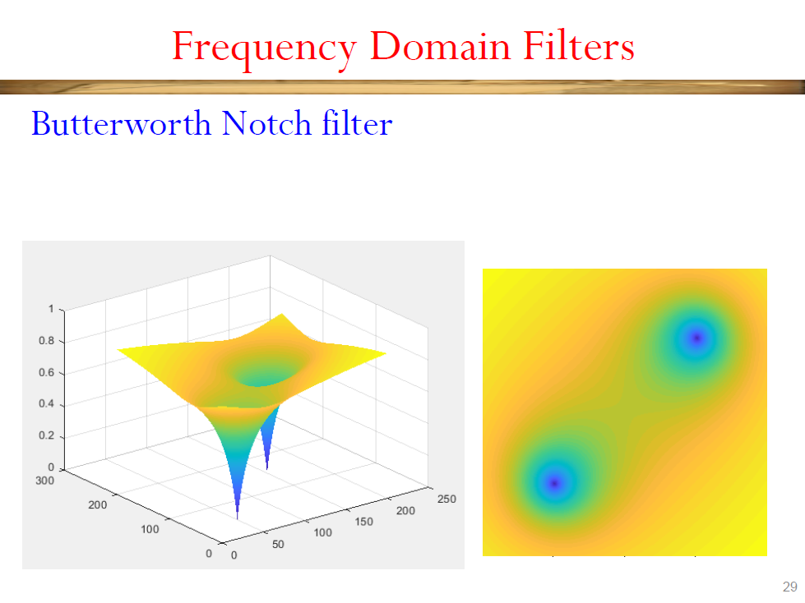

Slide 20
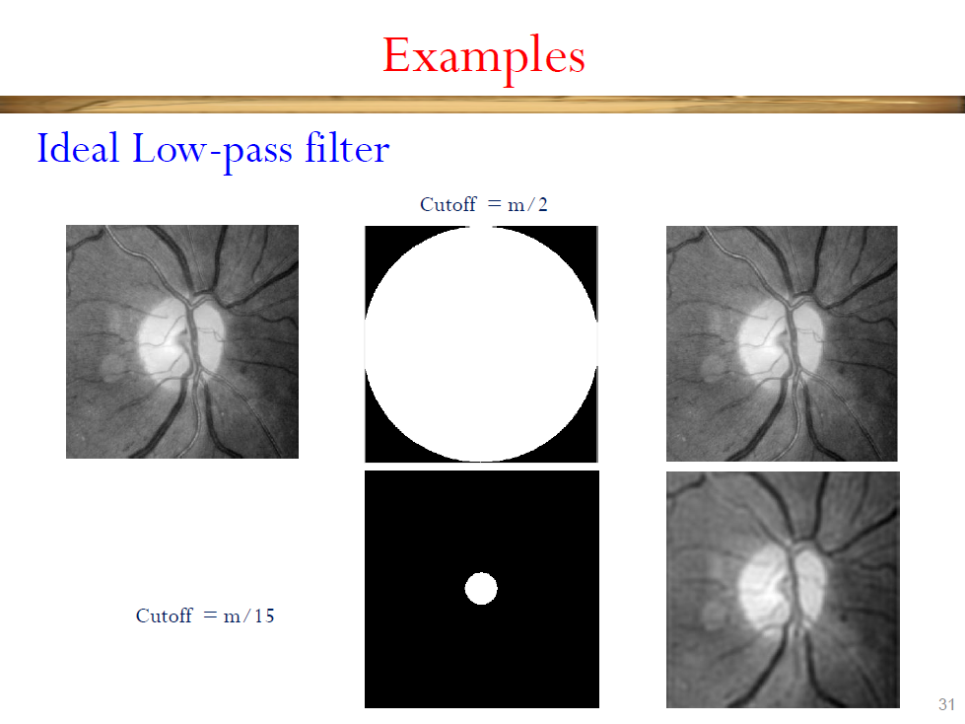

Slide 21
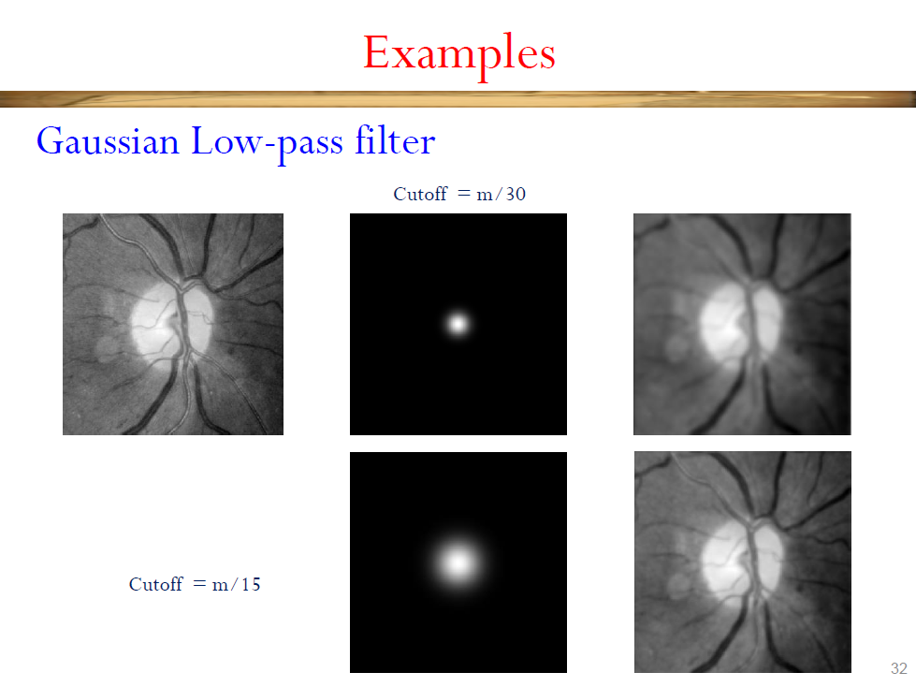

Slide 22


Slide 23
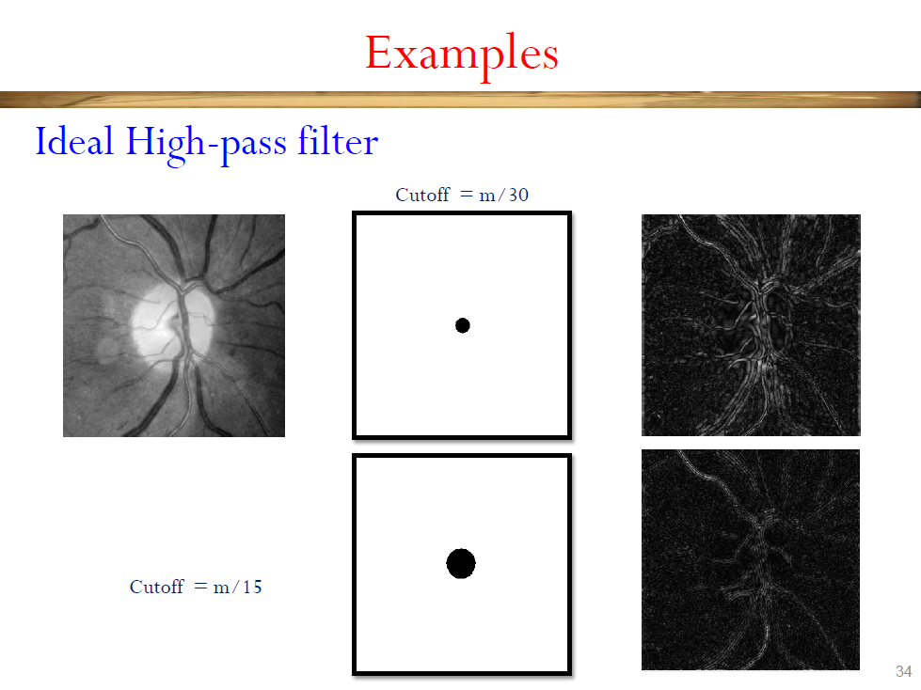

Slide 24
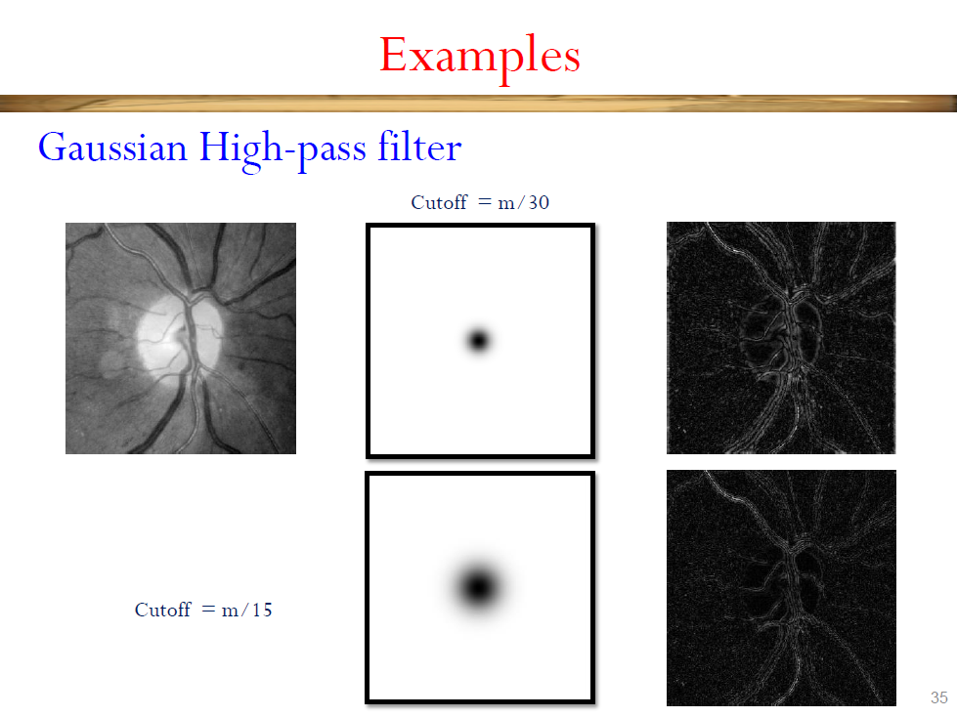

Slide 25
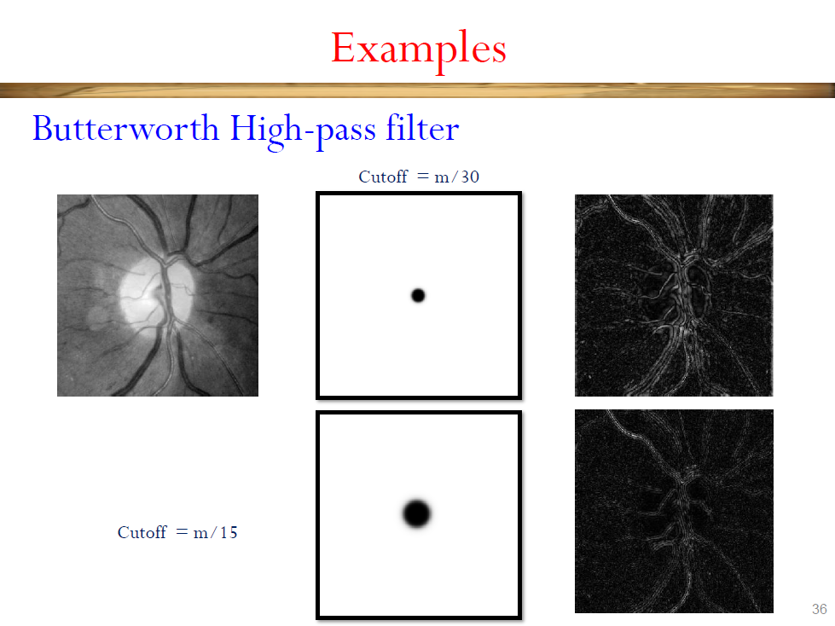

Slide 26
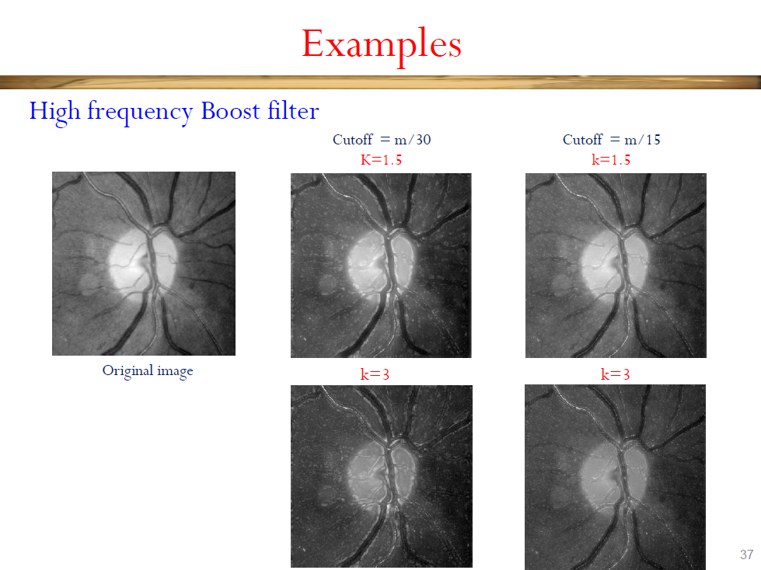

Slide 27
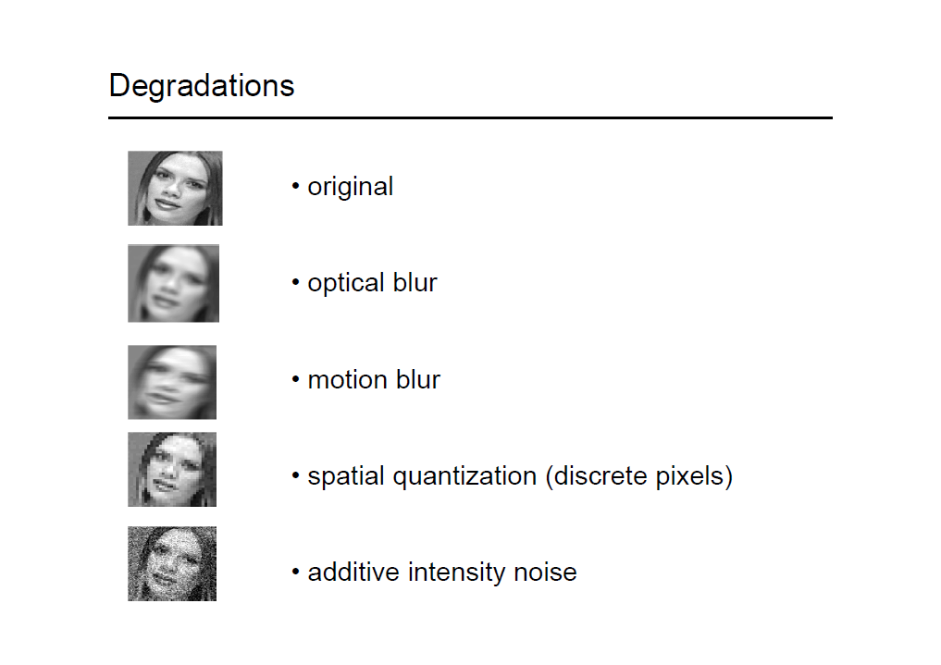
Image Restoration

Slide 30
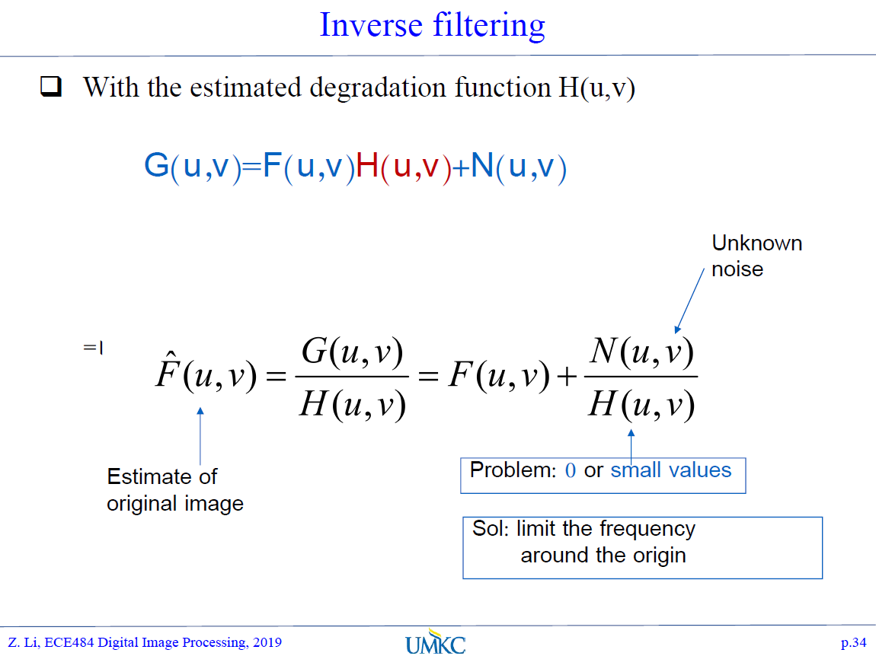

Slide 31
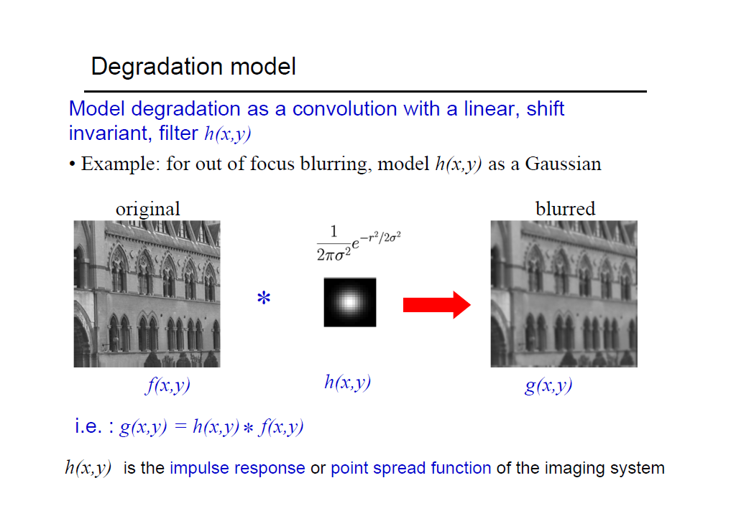

Slide 32
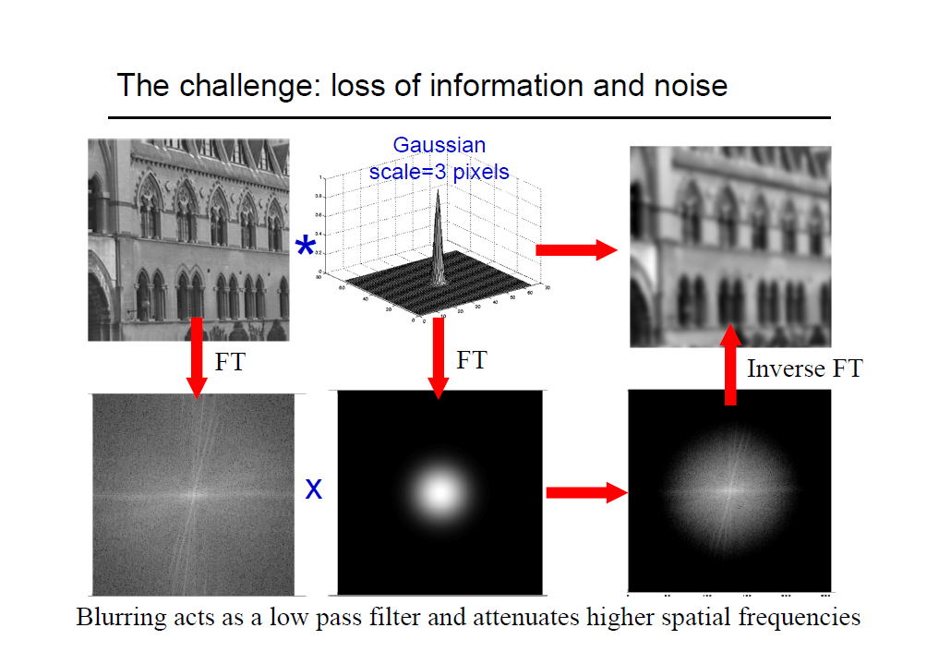

Slide 33
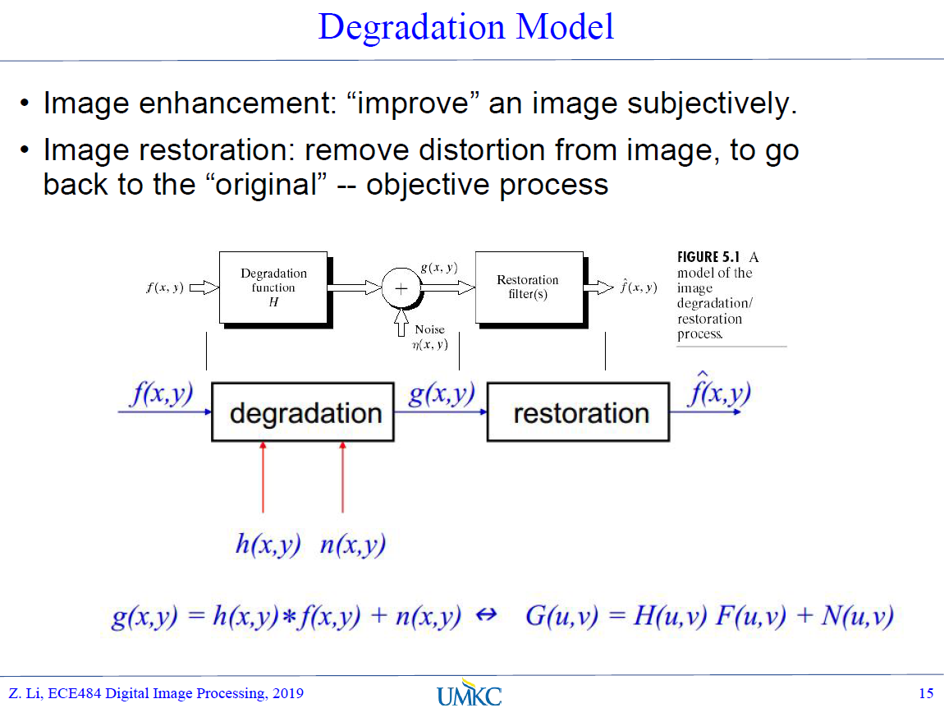

Slide 34
De-burring (reducing degradation)
Traditional method: Inverse Filtering in Frequency Domain

Slide 35
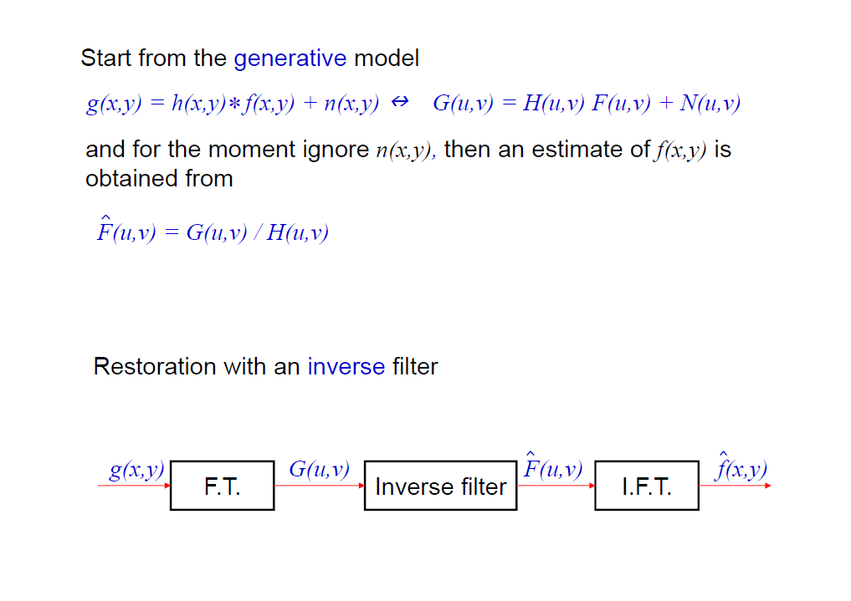

Slide 36
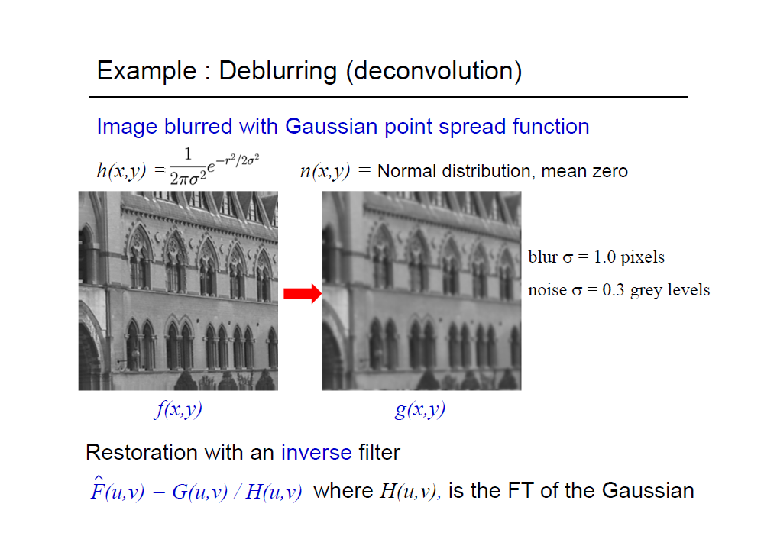

Slide 37
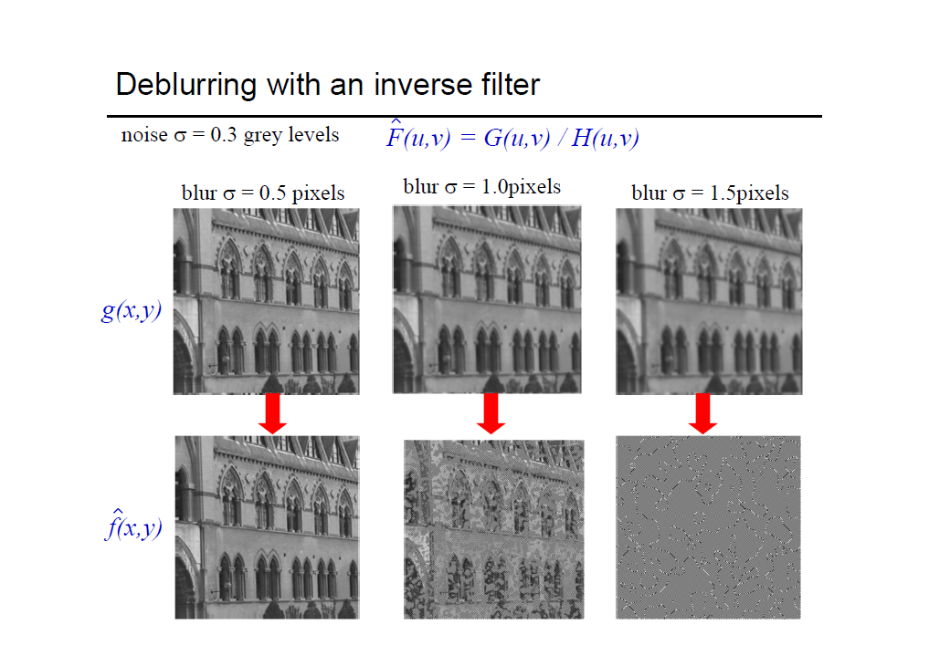

Slide 38
Deblurring
Deraining
Defogging
De-smog
Cyclic-GAN, Conv-AE, etc.

